Slide 1
Introduction to Parallel Computing
Course Instructor: Nausheen Shoaib

Slide 2
Marks Distribution
Assignment, Project & class activities: 20%
Mid Terms : 30%
Final: 50%
Book:
1. Introduction to Parallel Computing, Second Edition
by Ananth Grama, Anshul Gupta, George Karypis, Vipin Kumar
2. Distributed and Cloud Computing (From Parallel Processing to the Internet of Things) by Kai Hwang,Geoffrey C. Fox, Jack J. Dongarra.

Slide 3
OS Concepts Revision

Slide 4
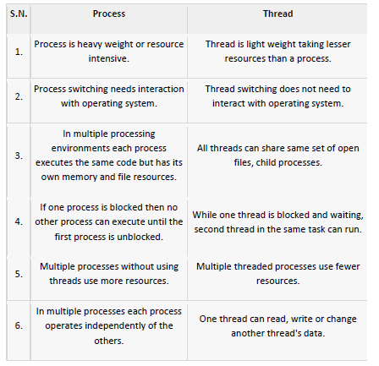
Process vs. Threads

Slide 5
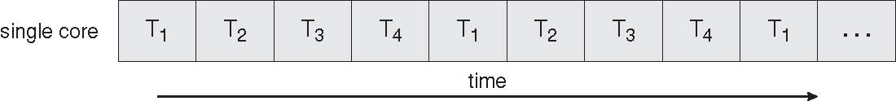
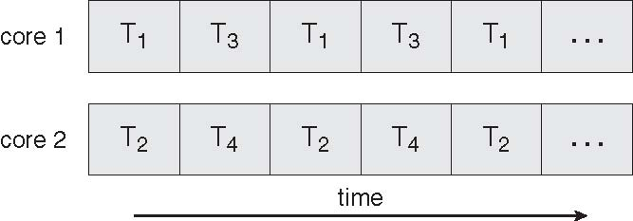
Concurrent Execution on a Single-core System
Serial Execution vs. Parallel Execution
Parallel Execution on a Multicore System

Slide 6
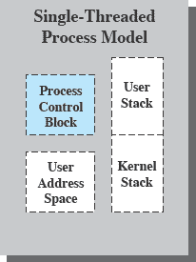
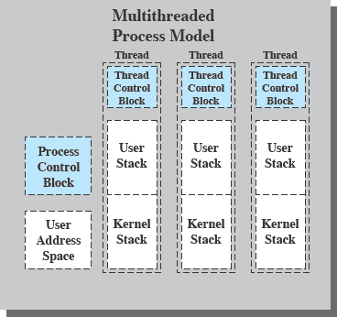
Single & Multithreading Process
Each thread has
An execution state (Running, Ready, etc.)
Saved thread context when not running
An execution stack
Some per-thread static storage for local variables
Access to the memory and resources of its process (all threads of a process share this)
Suspending a process involves suspending all threads of the process
Termination of a process terminates all threads within the process
6
PT / FF 2014

Slide 7
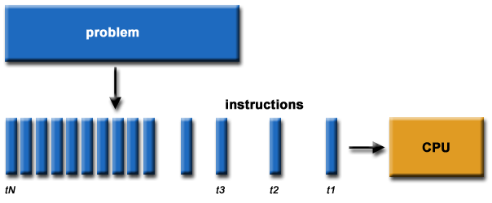
What is Parallel Computing? (1)
Traditionally, software has been written for serial computation:
To be run on a single computer having a single Central Processing Unit (CPU);
A problem is broken into a discrete series of instructions.
Instructions are executed one after another.
Only one instruction may execute at any moment in time.

Slide 8
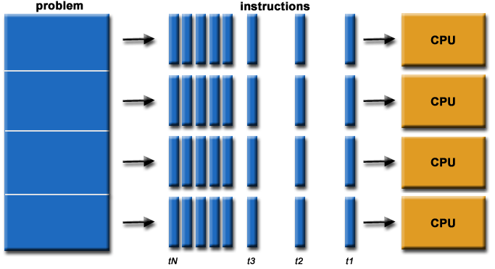
What is Parallel Computing? (2)
In the simplest sense, parallel computing is the simultaneous use of multiple compute resources to solve a computational problem.
To be run using multiple CPUs
A problem is broken into discrete parts that can be solved concurrently
Each part is further broken down to a series of instructions
Instructions from each part execute simultaneously on different CPUs

Slide 9


Parallel Computing: Resources
The compute resources can include:
A single computer with multiple processors;
A single computer with (multiple) processor(s) and some specialized computer resources (GPU, FPGA …)
An arbitrary number of computers connected by a network;
A combination of both.

Slide 10
Parallel Computing: The computational problem
The computational problem usually demonstrates characteristics such as the ability to be:
Broken apart into discrete pieces of work that can be solved simultaneously;
Execute multiple program instructions at any moment in time;
Solved in less time with multiple compute resources than with a single compute resource.

Slide 11
Parallel Computing: what for? (3)
Example applications include:
parallel databases, data mining
web search engines, web based business services
computer-aided diagnosis in medicine
advanced graphics and virtual reality, particularly in the entertainment industry
networked video and multi-media technologies
Ultimately, parallel computing is an attempt to maximize the infinite but seemingly scarce commodity called time.

Slide 12
Why Parallel Computing?
This is a legitime question! Parallel computing is complex on any aspect!
The primary reasons for using parallel computing:
Save time - wall clock time
Solve larger problems
Provide concurrency (do multiple things at the same time)

Slide 13
Limitations of Serial Computing
Limits to serial computing - both physical and practical reasons pose significant constraints to simply building ever faster serial computers.
Transmission speeds - the speed of a serial computer is directly dependent upon how fast data can move through hardware. Absolute limits are the speed of light (30 cm/nanosecond) and the transmission limit of copper wire (9 cm/nanosecond). Increasing speeds necessitate increasing proximity of processing elements.
Economic limitations - it is increasingly expensive to make a single processor faster. Using a larger number of moderately fast commodity processors to achieve the same (or better) performance is less expensive.

Slide 14

Amdahl’s Law
gives the theoretical speedup in latency of the execution of a task at fixed workload that can be expected of a system whose resources are improved
Where S = portion of program executed serially
N = Processing Cores

Slide 15
Amdahl’s Law Example
we have an application that is 75 percent parallel and 25 percent serial. If we run this application on a system with two processing
cores?
S=25%=0.25, N= 2
If we add two additional cores , calculate speedup?

Slide 16
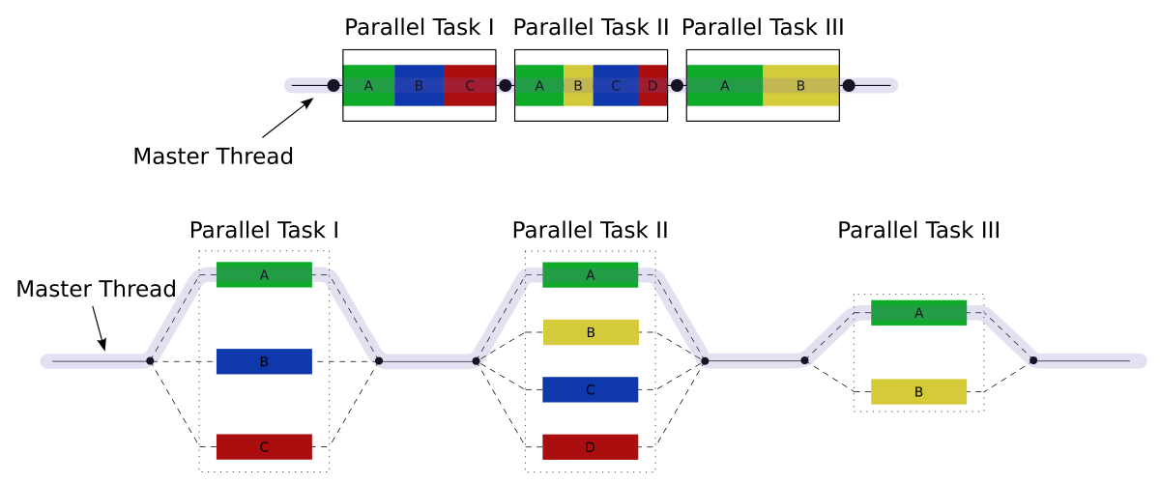
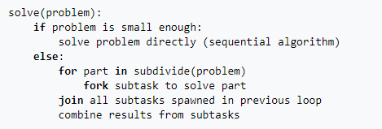
Fork – Join Model

Slide 17
Concepts and Terminology

Slide 18
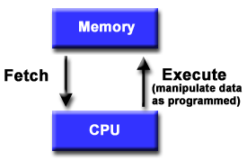
Basic Design
Basic design
Memory is used to store both program and data instructions
Program instructions are coded data which tell the computer to do something
Data is simply information to be used by the program
A central processing unit (CPU) gets instructions and/or data from memory, decodes the instructions and then sequentially performs them.

Slide 19
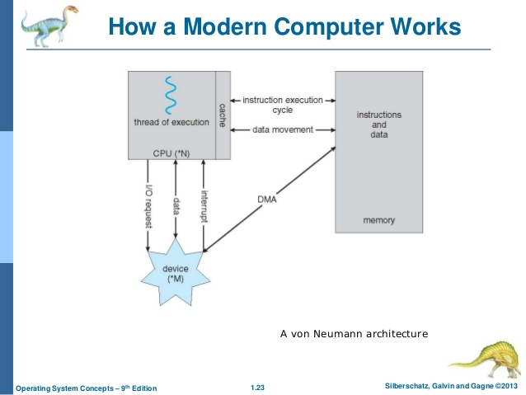
Von Nueman Architecture

Slide 20
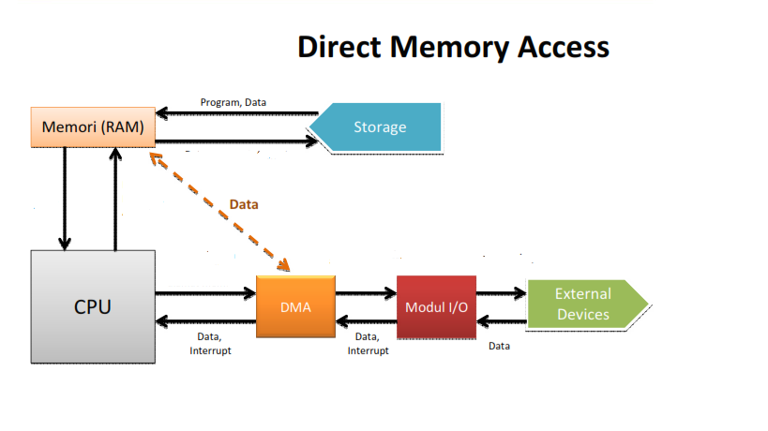
Direct Memory Access Structure
Used for high-speed I/O devices able to transmit information at close to memory speeds
Device controller transfers blocks of data from buffer storage directly to main memory without CPU intervention
Only one interrupt is generated per block, rather than the one interrupt per byte

Slide 21
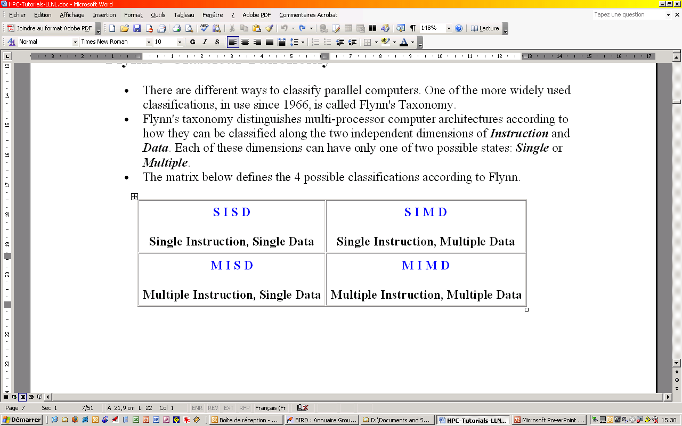
Flynn Taxanomy
The matrix below defines the 4 possible classifications according to Flynn

